Slide 2

Time to drop a…
TRUTH
Photo by Karolina Grabowska
@LeonAdato
Notes:
Start with a truth bomb
If there's one thing I’ve learned over my career in tech, it’s that we’ll get to choose.
A lot

Slide 3
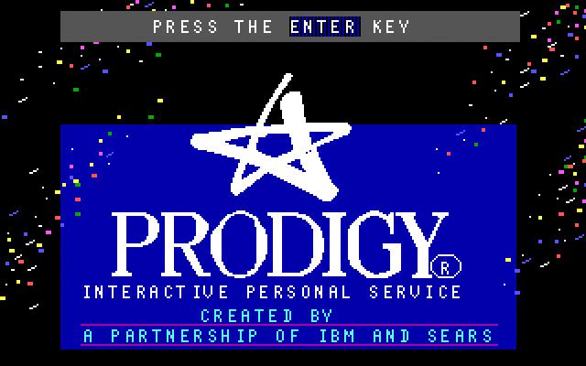
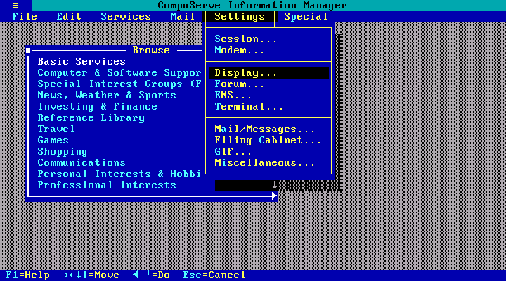
WHAT choice?!?
Notes:
We may not like WHAT you're choosing,

Slide 4
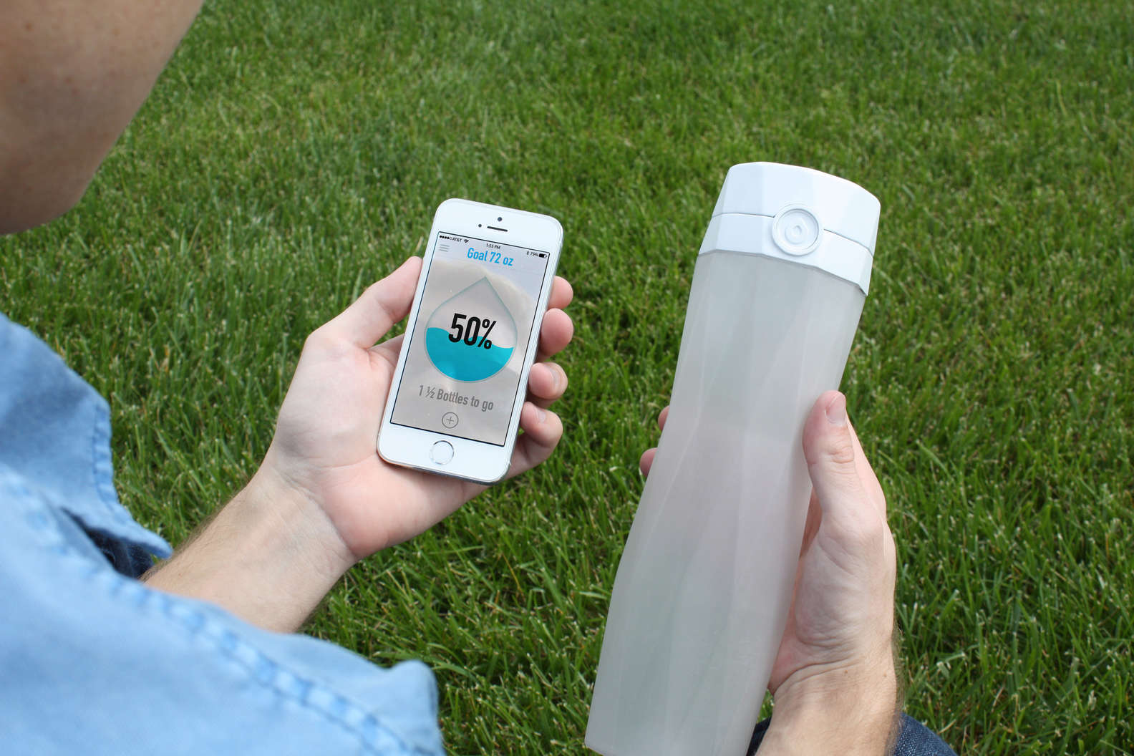
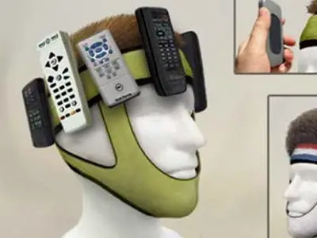
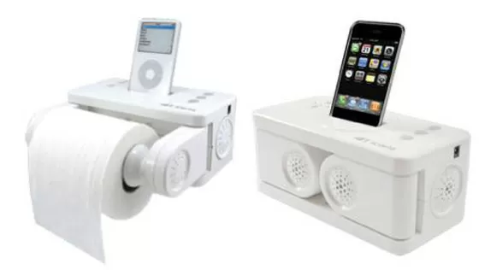
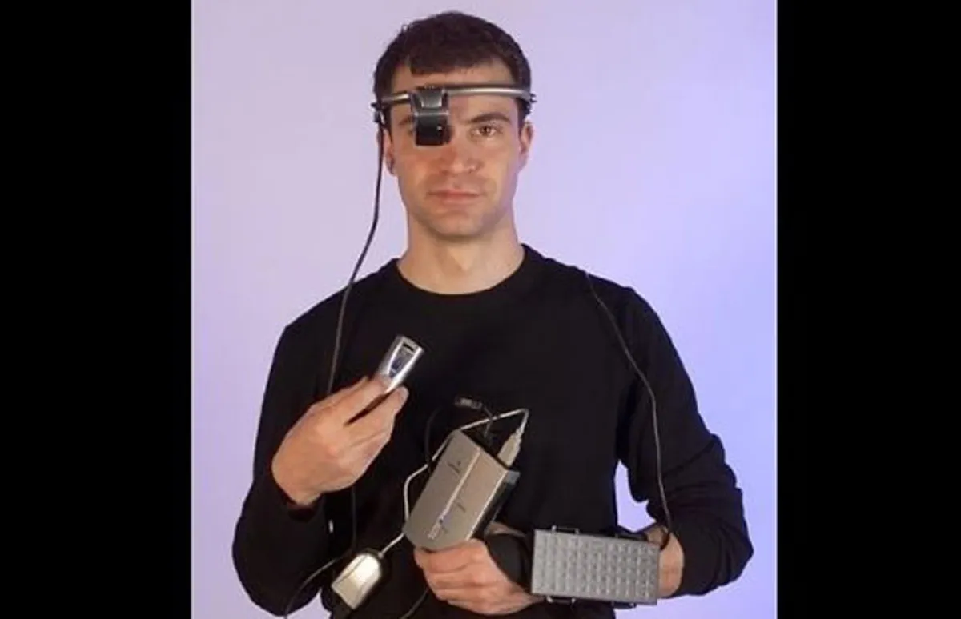
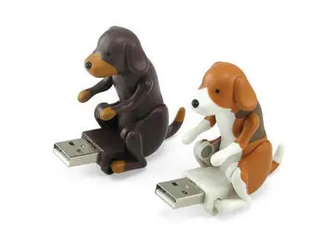
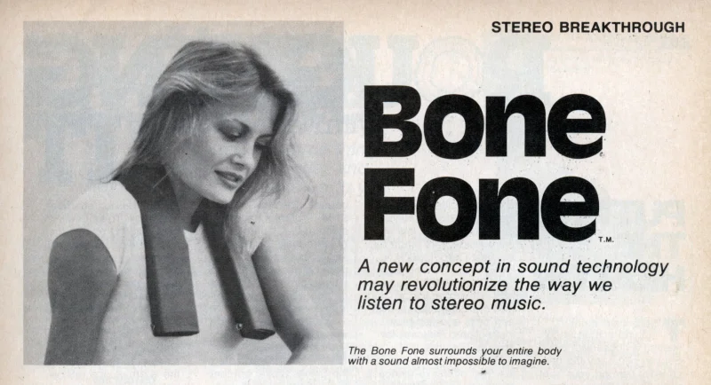
Whyyyyyy?!?
@LeonAdato
Notes:
or WHY we have to choose these things at all

Slide 5
S.N.A.F.U.
1999 - Y2K bug avoidance
2000 - Everyone in I.T. takes a nap
2001 - Dot-com bubble bursts
2002 - Amazon launches AWS
2003 - WiFi deployed to >6,000 hotels
2004 - Gmail debuts
Google indexes >8 million pages
2005 - YouTube uses more bandwidth in 1 year than the entire internet did in 2000
2006 - Y Combinator kicks off investment frenzy
Amazon launches ECC
2007 - iPhone (an later, Android) debut
2008 - Stack overflow, Github, Twilio debut
2009 - Iomega Rev drive debuts
2010 - iPad debuts
4.7 billion mobile phone subscriptions
2011 - >600,000 iPhone/iPad apps
>400,000 Android apps.
>800 million FB users
Revolution in the middle east enabled by mobile phone use
2012 - Tablet computers become the fasted adopted hardware in history.
2015 - Windows 10
2020 - Pandemic causes global WFH overnight
2021 - SolarWinds hack
something something blockchain
2023 - the rise of LLM and generative AI.
@LeonAdato
Notes:
Or how often.
Don’t read this slide. It’s an eye exam that says “shit changes all the time”
biggest laughs at the start of pandemic was all the media talking about the "new normal"
"Oh, you mean when everything we knew gets thrown out the window
and we have to find a completely different way to do every aspect of our jobs?
Yeah, in tech we have a word for that. We call that "Oh, look, it's Tuesday!"

Slide 6

Photo by Alexander Schimmeck
@LeonAdato
Notes:
The sheer volume of opportunities to choose creates a number of challenges,
but maybe none so much as the paralyzing fear that we might choose wrong.

Slide 7
Looking back at a lifetime
of poor technical choices
$speaker_name();
$date();
Notes:
Which is the point of my talk today
Thank you for joining me as I look back across a lifetime of poor tech choices.

Slide 8

$Speaker_Name();
For $i in count($About_you) {
print(f”$i”) ;
}
For $x in count($socials) {
print(f”$x”) ;
}

Slide 9
The Lede
There's no such thing as a poor technical choice
@LeonAdato
Notes:
After xx years in tech, I’ve learned something I want to share with you all
Right up front.
CLICK! There's no such thing as a poor tech choice.
I know, because I’ve made some doozies.
Today I’m going to share just a few residents living in my technical house of horrors.

Slide 10
OK, maybe there are a couple
Not having backups
Thinking replicas, mirrors, RAID, or SAN are backups
Unsecured S3 bucket
Moving fast and breaking things… in PRODUCTION
Using production AS your test environment
Trying to do it all yourself.
Using Oracle
Starting a land war in Asia
@LeonAdato
Notes:
I take that back. There are COMMON decisions that are clearly bad

Slide 11
Bad choice story #1
@LeonAdato

Slide 12
Bad choice story #2
@LeonAdato

Slide 13
Bad choice story #3
@LeonAdato

Slide 14
Poor Technical Choice Rubbernecking
Two sev 1 events, 1 week apart
Both from a config change in prod
One person walked to the door
One person given a stern talking to
@LeonAdato
Notes:
Wasn’t me this time!
(read slide)
Difference?
First person made the change, saw the result, and immediately flagged it and owned it.
Couldn’t fix it, but offered to be there through the process, to learn what they could
Second person made the change, saw the result, and tried to bury it.
But there are always logs.
Lessons here are obvious. Don’t try to hide your mistakes.
There isn’t (or shouldn’t be) the expectation of perfection.
But there is (or should be) the expectation of decency.

Slide 15
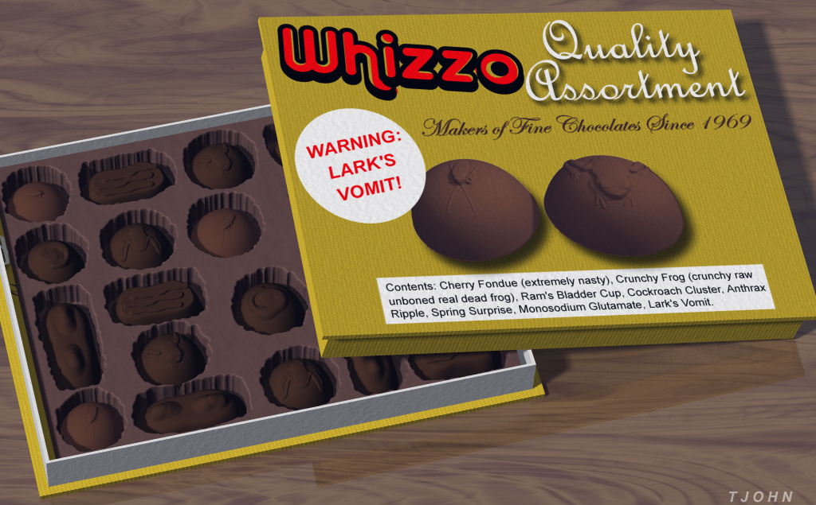
Choose your own adventure disaster
@LeonAdato
Notes:
As I said at the beginning, the sheer number of choices and the possible negative outcomes can be paralyzing.
It’s a whitman’s sampler of possible crap

Slide 16
Choose your own adventure disaster
Doing Kubernetes
NOT doing Kubernetes
ChatGPT
Blockchain
Using <this> framework
…or language
…or platform
AWS vs Azure vs GCP
Oracle
On prem vs colo vs cloud vs hybrid
Monitoring with x solution
…vs y solution
…vs ALL the solutions
…vs building it yourself
@LeonAdato
Notes:
Read slide
Paralyzing because doing it wrong,
but also because doing the wrong thing might distract us
From doing the new thing, or the cool thing,
and we’ll get left behind.

Slide 17
“There's always a next thing” - Seth Godin
This thing, the thing we have now,
is worth working with,
because it offers so many opportunities
compared with merely waiting
for the next thing.
@LeonAdato
Notes:
Seth Godin addressed this inherent fear many of us have
Technical FOMO
The fear of not getting onto the next thing
That causes us to hesitate to get involved in something now.
But…
CLICK

Slide 18
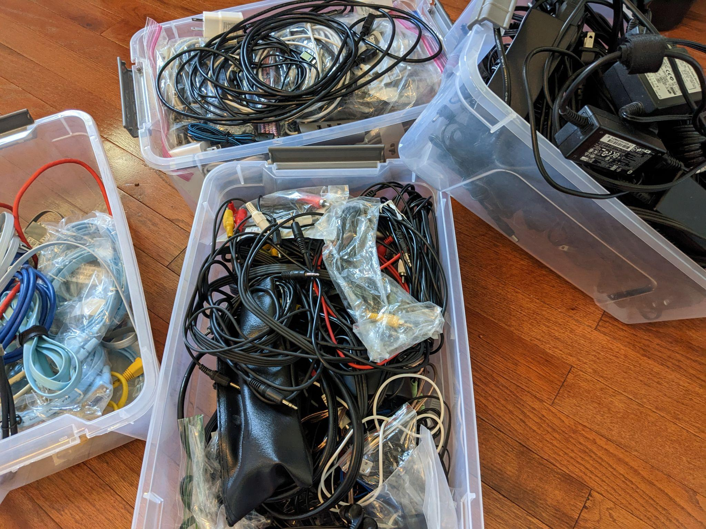
What’s the REAL lesson?
There are no bad tech choices?
The real treasure was the cables we collected along the way?
Or maybe it’s something else… ?
@LeonAdato
Notes:
CLICK!
I know I said my point was that there are no poor tech choices,
but it can’t be that banal or predictable.
CLICK! Was the real treasure the cables we collected along the way?
CLICK Maybe it’s something else

Slide 19
Misspent Youth
(childhood experiences)
@LeonAdato
Notes:
CLICK! Loquacious: “tending to talk a great deal”. 4th grade, on report card.
I’d see it again a lot. And “overly communicative”, “oversharing. And “diarrhea of the mouth”.
CLICK! If you wanted to know who made a fart noise at 11:15am in social studies, I was your guy.
My notes may not have covered the facts of the 1812 war, in their own way comprehensive
CLICK From time I was 10 yrs old through college, 100% of my time was spent pursuing a career in theater.
in fact, senior year hs 2 academic and 7 choir, drama, band
CLICK All that time and I’m not doing any of it today
All poor uses of my time.
But…

Slide 20
There are no poor technical choices because:
It’s not about the tech.
It was never about the tech.
It will always be about you.
@LeonAdato
Notes:
there really aren't any poor tech choices because:
It’s not about the tech
It was never about the tech
It will always be about you

Slide 21
@LeonAdato
Notes:
this slide is intentionally blank, to leave room for what you bring to the story.
We pick up technical puzzle pieces throughout our journey, and often they seem to have no place go to.
But the truth is, they will fit somewhere, eventually.
There’s never going to be part of your skills, your experience, your life that won’t apply at some point.
The trick, the lesson, is we have to commit ourselves to showing up, ready to apply both who we are, and what we know
If we do that, there is no such thing as a poor technical choice.

Slide 22
Thank you!

